Slide 1
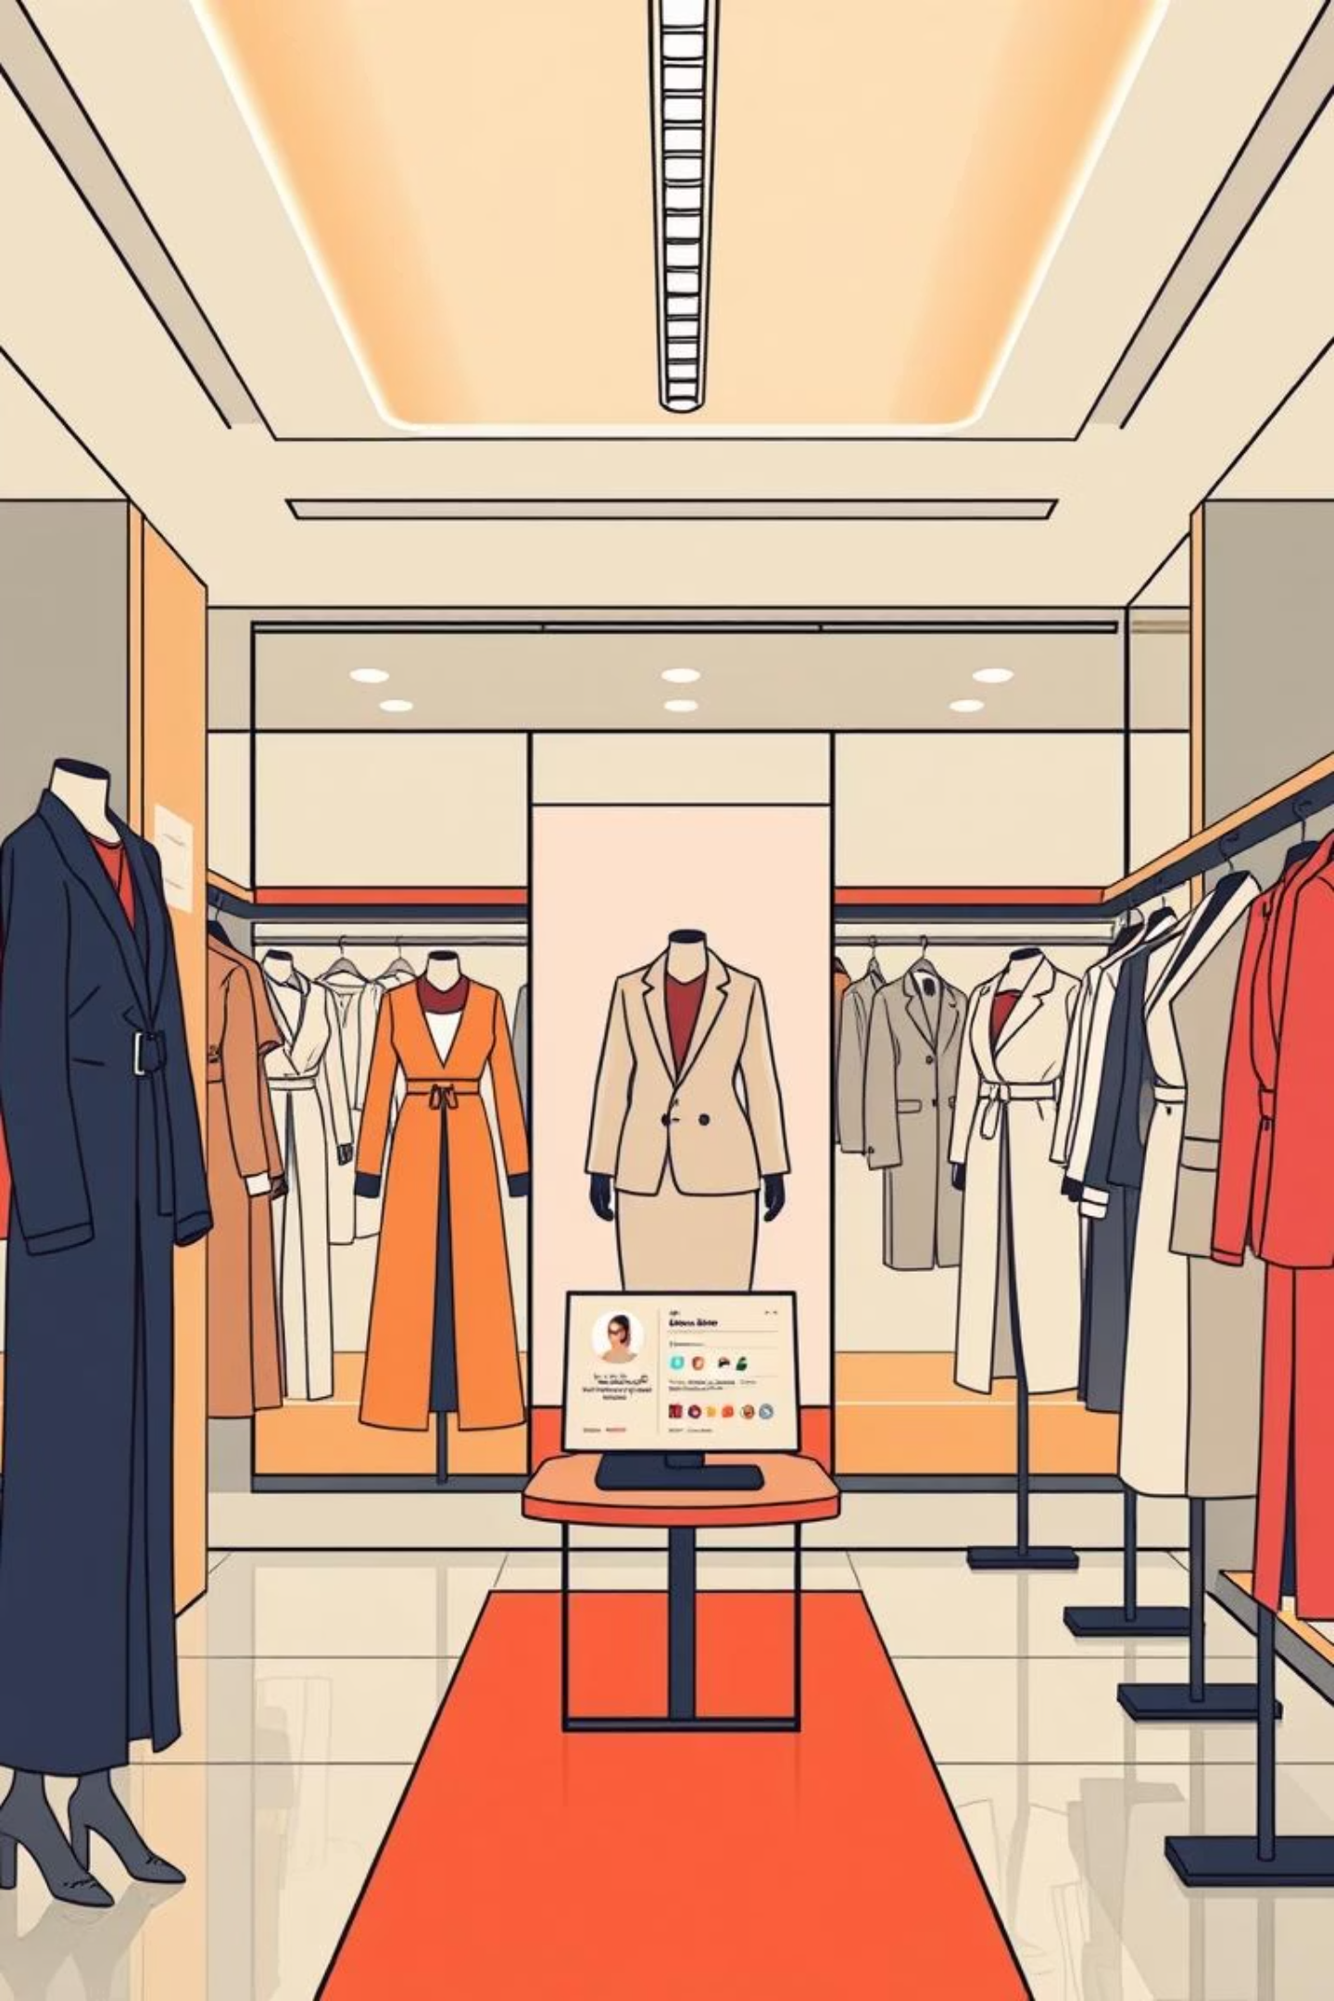
Fashion AI Chatbot: Your Personal Style Assistant
Imagine having a personal stylist in your pocket 24/7 – that’s exactly what we’ve built! Our smart fashion assistant interacts with you like a human stylist, offering personalised advice and recommendations.

Slide 2



THE MAGIC BEHIND THE SCENES
How Our AI Stylist Works
Vision System
Memory System
Recommendation Engine
Our AI "sees" and understands fashion. Upload a photo of your outfit, and it identifies details like "casual blue denim jeans" or "white cotton T-shirt."
It remembers your preferences and past conversations. If you often ask about casual wear, it learns your style and suggests more relaxed options over time.
Like a smart shopping assistant, it knows what pieces complement each other. Ask for "work outfits," and it suggests blazers, dress pants, and professional shoes.

Slide 3
THE USER EXPERIENCE
Real-Life Styling Scenarios
Scenario 1: The Busy Professional
Scenario 2: The Fashion Enthusiast
Mike needs an outfit for a tech interview but lacks fashion sense.
Emma loves fashion but wants to explore new styles for her new floral dress.
Mike uploads a closet photo and asks for interview help.
Emma uploads her dress and asks for versatile styling tips.
AI suggests: "Navy blazer, grey pants, white shirt, brown leather shoes. Stick to professional tones."
AI suggests: "For work: add a blazer and flats. For brunch: denim jacket and sneakers. For date night: statement jewellery and heels."
Mike gets specific product recommendations with prices.

Slide 4




BUILDING BLOCKS
The Technical Architecture
Frontend: User Interface
Backend: The AI Brain
Built with Streamlit, this is what you see—a clean, intuitive chat interface with image upload buttons for seamless interaction.
Powered by OpenAI GPT-4 with vision capabilities, it processes your requests and suggests outfits based on factors like fabric, season, and occasion.
Database: Memory Storage
API Server: Connectivity
An SQLite database organises thousands of fashion items, storing details like colour, season, and occasion, enabling relevant and quick suggestions.
Using the FastAPI framework, this component seamlessly connects the chat interface to the AI brain, ensuring smooth communication and integration.

Slide 5
KEY DIFFERENTIATORS
Smart Features That Make It Special
Personalised Learning
Smart Recommendations
Our AI tracks your preferences, learning your style from your questions. If you ask about "casual Friday" outfits, it learns your business-casual preference.
It considers season, occasion, budget, and personal style. Expect suggestions for winter coats in December, not summer dresses!
Image Intelligence
Natural Conversation
It analyses uploaded photos pixel by pixel, recognising details like "vintage leather jacket" and suggesting complementary items.
Our AI understands context and maintains conversation flow, asking follow-up questions to provide precise advice.

Slide 6
INNOVATION
Problems We Solved with AI
Fashion Paralysis
Expensive Stylists
Too many choices can be overwhelming. Our AI provides instant guidance, eliminating stress and indecision.
Personal styling sessions cost a lot. Our AI offers free, 24/7 access to professional styling advice.
Outfit Repeating
Seasonal Confusion
People often wear the same combinations. Our AI suggests creative new mixes from your existing wardrobe.
Not knowing what's appropriate for different weather or occasions is a common issue. Our AI automatically adjusts suggestions based on time and weather.

Slide 7

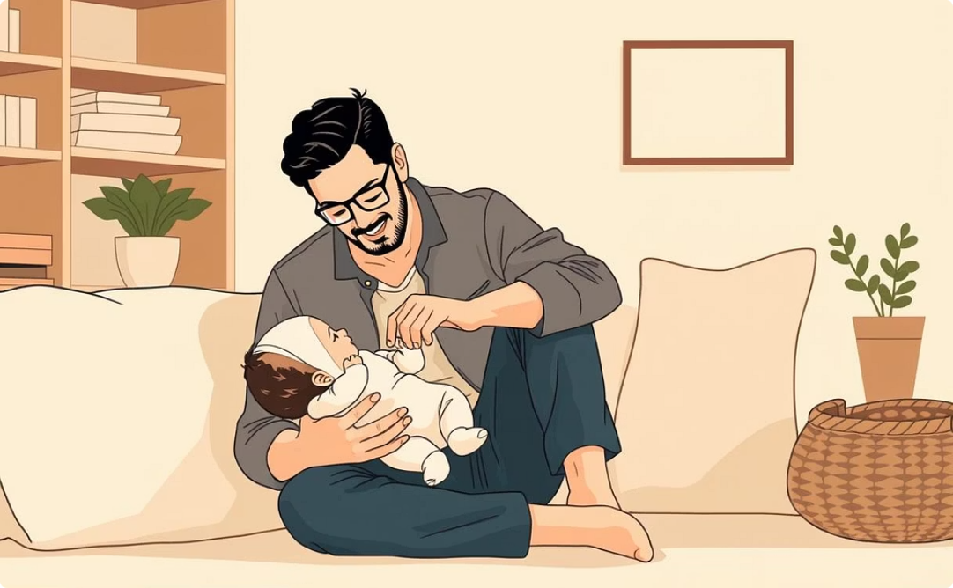
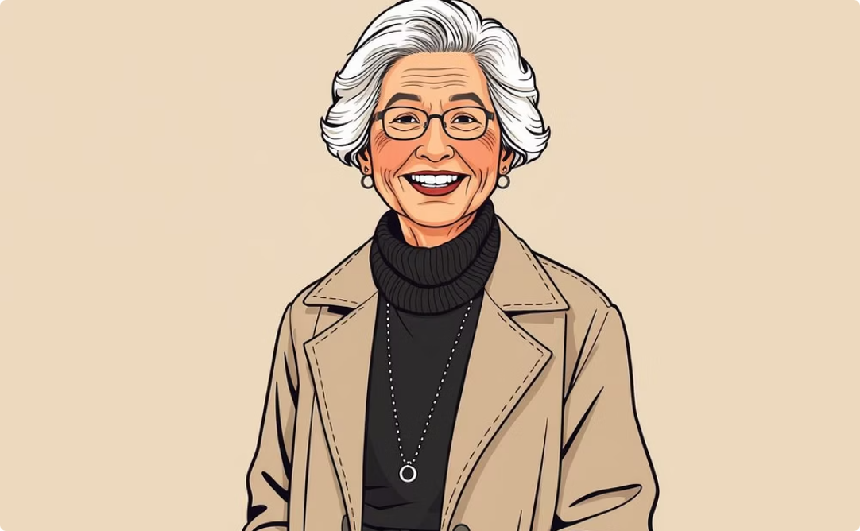
EMPOWERING LIVES
Real-World Impact Examples
Student Sarah 🎓
New Dad David 👨‍🍼
Grandmother Grace 👵
With a limited budget, Sarah needed to look professional for internship interviews. Our AI suggested creative mixes of her existing pieces, helping her look sharp without buying new clothes.
Too busy to shop, David needed a style update. Our AI analysed his wardrobe and suggested strategic additions, giving him a modern look with minimal effort and expense.
Grace wanted to dress fashionably but felt outdated. Our AI suggested age-appropriate trendy pieces, helping her feel confident and stylish.

Slide 8



THE JOURNEY
Technical Challenges We Overcame
Teaching AI About Fashion
We trained the AI with thousands of fashion combinations and explanations, enabling it to understand style concepts like "black goes with everything."
Understanding Images
Using advanced vision AI, we taught the system to differentiate between items like a summer dress and a winter coat, analysing fabric, cut, and style.
Remembering Conversations
We built a memory system that recalls past preferences, ensuring personalised and natural conversations, avoiding starting from scratch each time.

Slide 9
THE ROAD AHEAD
Future Possibilities
Coming Soon
Dream Features
Virtual Wardrobe: Digitally catalogue your entire closet.
AR Try-On: See how clothes look on you virtually.
Weather Integration: Outfit suggestions based on daily weather.
Seasonal Swaps: Automatic suggestions for wardrobe transitions.
Shopping Assistant: Find exact recommended items with price comparisons.
Event Planning: Complete outfit planning for vacations and events.
Social Features: Share outfits and get feedback from friends.

Slide 10
THE VISION
Why This Matters: Fashion Meets Future
We've created a personal stylist that never sleeps, never judges, and always helps you look your best.
Personal Confidence
Time-Saving
Money-Smart
Looking good makes people feel better, boosting self-esteem.
No more morning outfit stress, saving valuable time.
Make better shopping decisions, reducing waste and expense.
The best technology solves real, everyday problems. Our AI makes professional styling accessible to everyone, ensuring continuous learning and personalised growth.

